Slide 1
Big Data Analytics Project
- PHASE 1

Slide 2
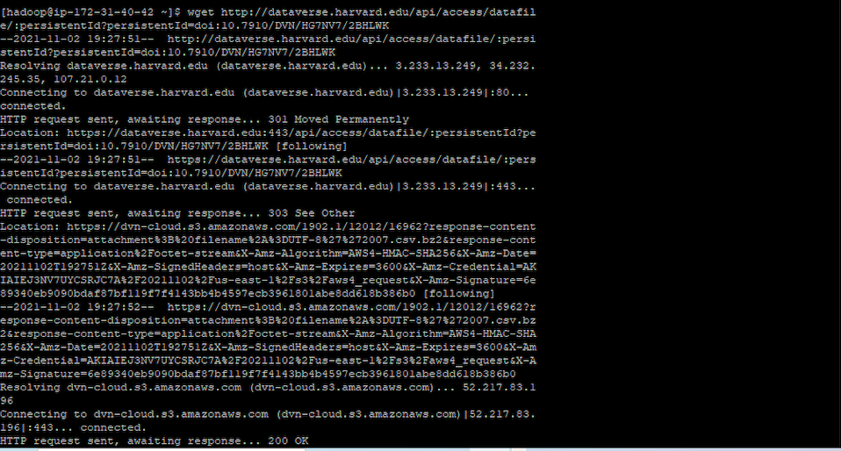
Data Download

Slide 3
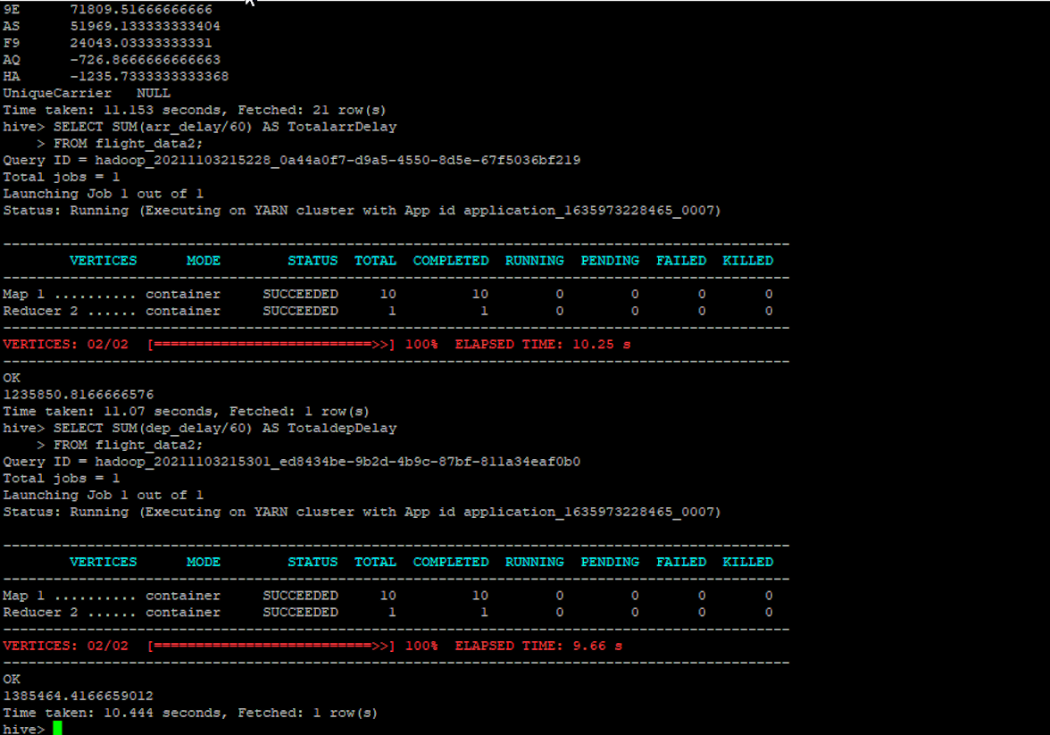

Slide 4

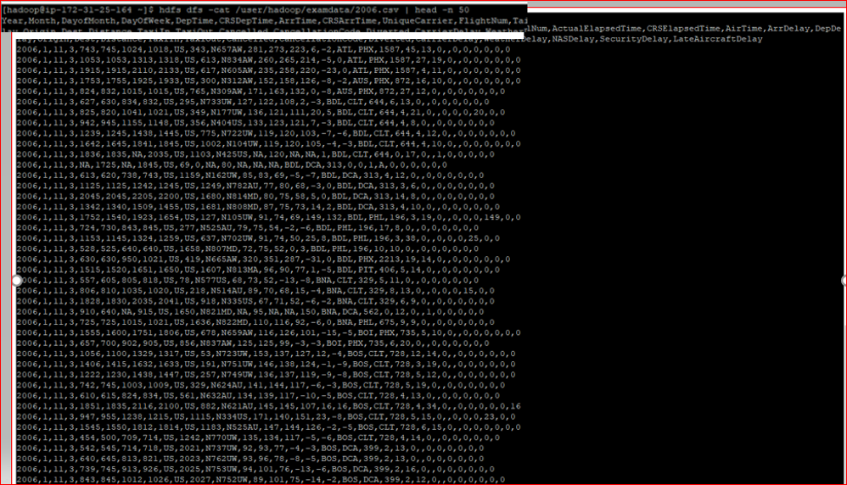
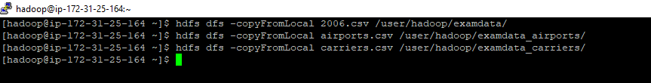
1. Creating 3 different directories at HDFS:
2. Copy data from Local to HDFS:
3. Sample 50 records from HDFS:
Command:
hdfs dfs -cat /user/root/2006.csv | head -n 50

Slide 5
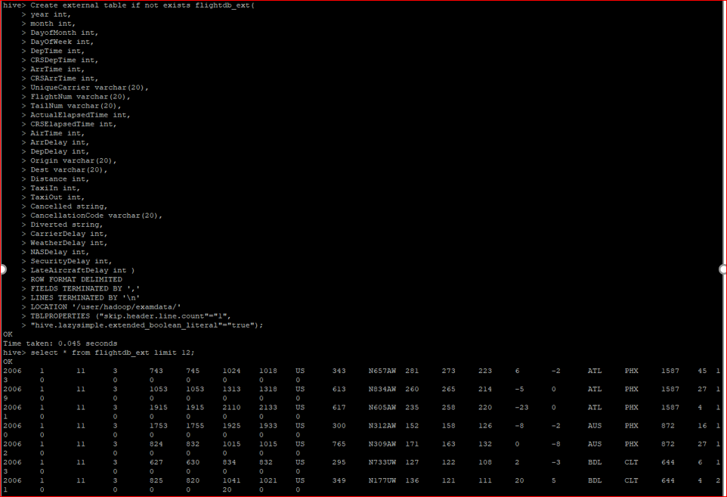
Create external table by reading a file from HDFS

Slide 6
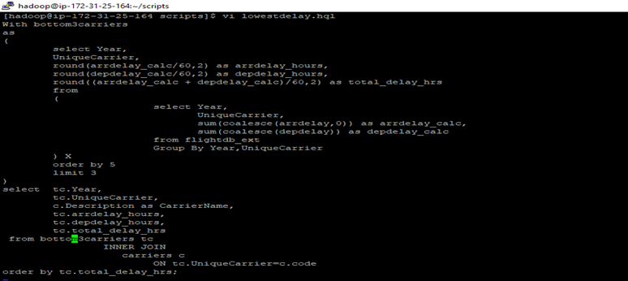
SCRIPT TO DETERMINE THE THREE CARRIERS WITH THE LOWEST DELAY TIME (IN HOURS) FOR YEAR 2006

Slide 7
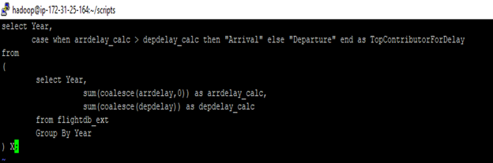
SCRIPT TO DETERMINE LARGEST CONTRIBUTOR ARRIVAL OR DEPARTURE DELAY

Slide 8
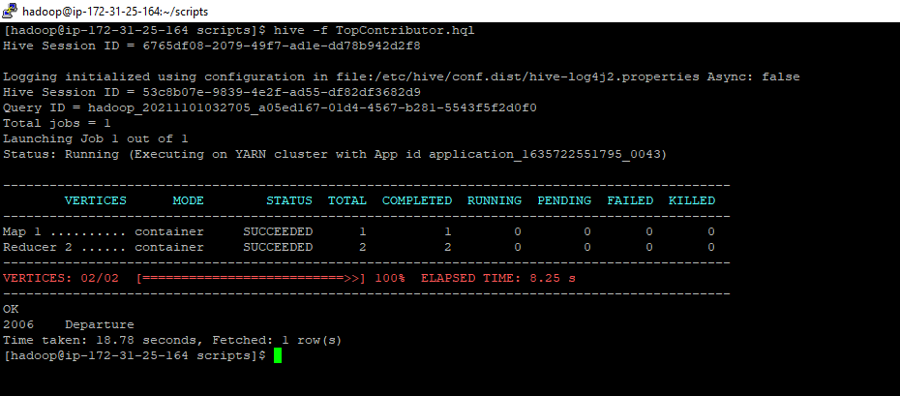
Output : Departure delay is the largest contributor for 2006 year

Slide 9
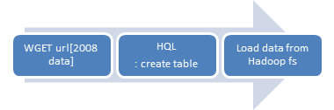

Approach for the Dataset

Slide 10
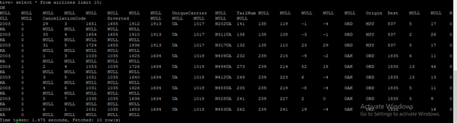
Display a sample of the loaded rows

Slide 11
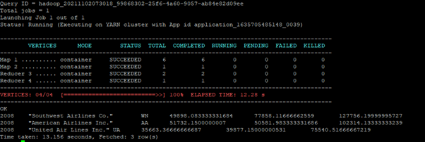
Highest delay

Slide 12
Highest Delay
Year | Carrier | Carrier Name | Arrival Time Delay | Departure Time Delay | Total Time Delay
2008 | WN | Southwest airlines .co | 49898.08 | 77850.11 | 127756.1999
2008 | AA | American airlines | 51732.150 | 50581.98 | 102314.133
2008 | UA | United Air lines Inc. .co | 35663.36 | 39877.1500 | 75540.516

Slide 13
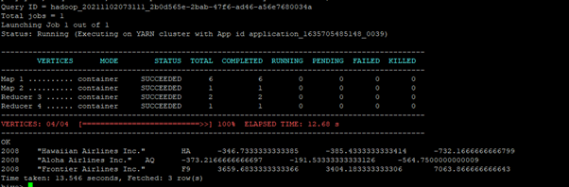
Lowest delay

Slide 14
LOWEST DELAY
Year | Carrier | Carrier Name | Arrival Time Delay | Departure Time Delay | Total Time Delay
2008 | HA | HAWAIIAN AIRLINES .INC | -346.7333 | -385.433 | -732.16
2008 | AQ | ALOHA AIRLINES | -373.216 | -191.533 | -564.75
2008 | F9 | FRONTIER AIRLINES.. | 3659.68 | 3404.183 | 7063.866

Slide 15
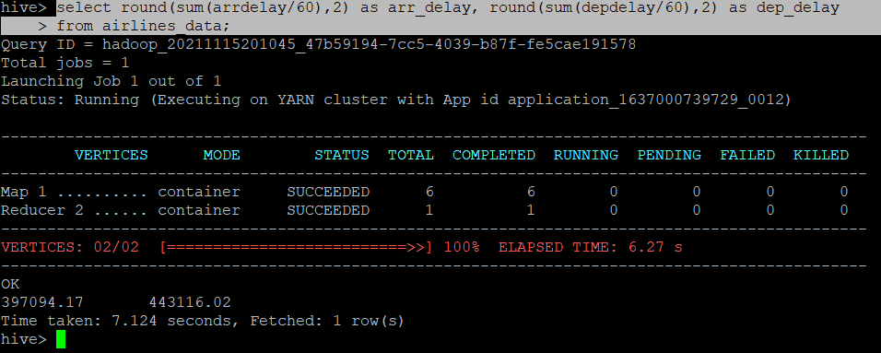
TotalArrivalDelay(397094.17) < TotalDepartureDelay(443116.02)

Slide 16
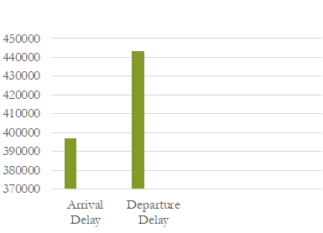
Therefore Departure type time delay is the largest contributor for 2008 year from arrivals or departures.

Slide 17
Conclusion

Slide 18
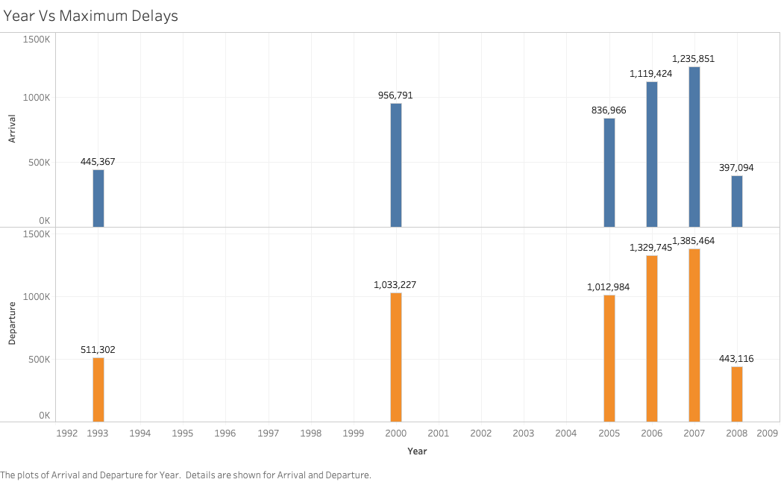
Largest Contributor Comparison in Years

